Slide 1
How to set up your account
vetpmp.org

Slide 2
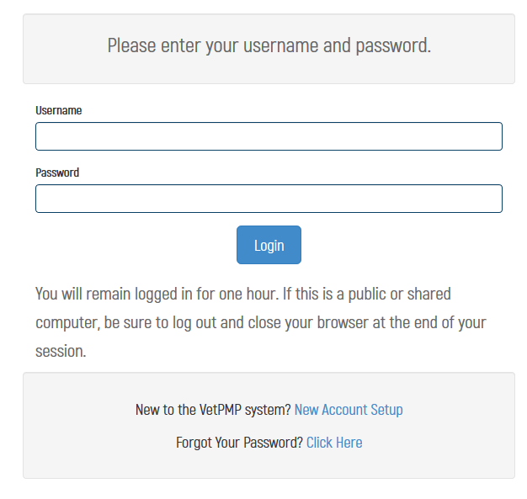
Visit www.vetpmp.org

Slide 3
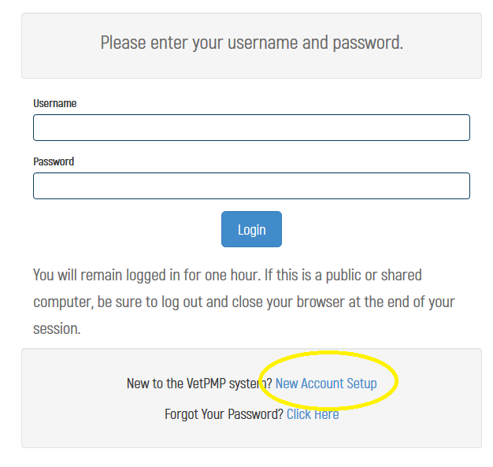
New Account Set-up
Click “New Account Setup”

Slide 4
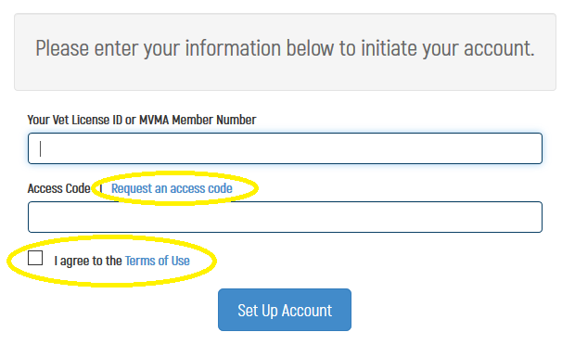
New Account Set-up

Slide 5
Initiate your account
Enter License / Certification Number
CVTs will be sent their Certification Number
Enter temporary access code
Click to “Request an access code” if you don’t have one
Check Terms of Use Box
Click Set Up Account

Slide 6
Establish user name and password
Select user name
Select password
Needs to be at least 8 letters and have at least 1 number

Slide 7
Select your clinic(s)
Click “Add a Clinic”
Search by name, city, or zip code
Click “Add” button

