Slide 1
How to look up a pet’s controlled drug history
vetpmp.org

Slide 2
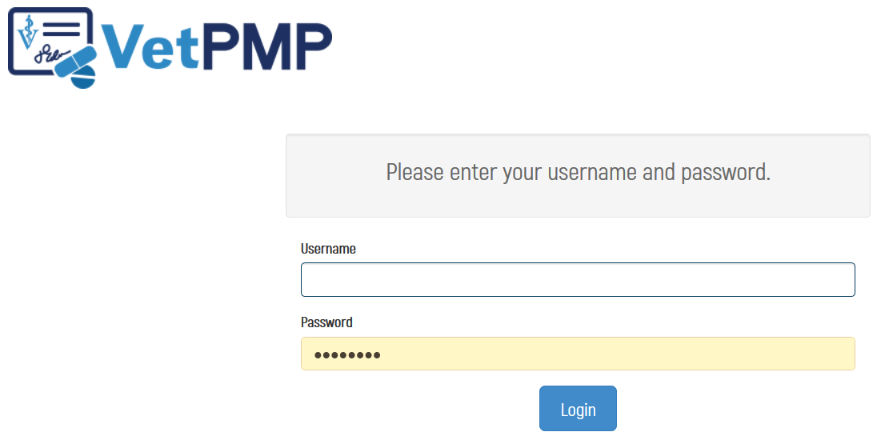
Log-in at www.vetpmp.org.

Slide 3
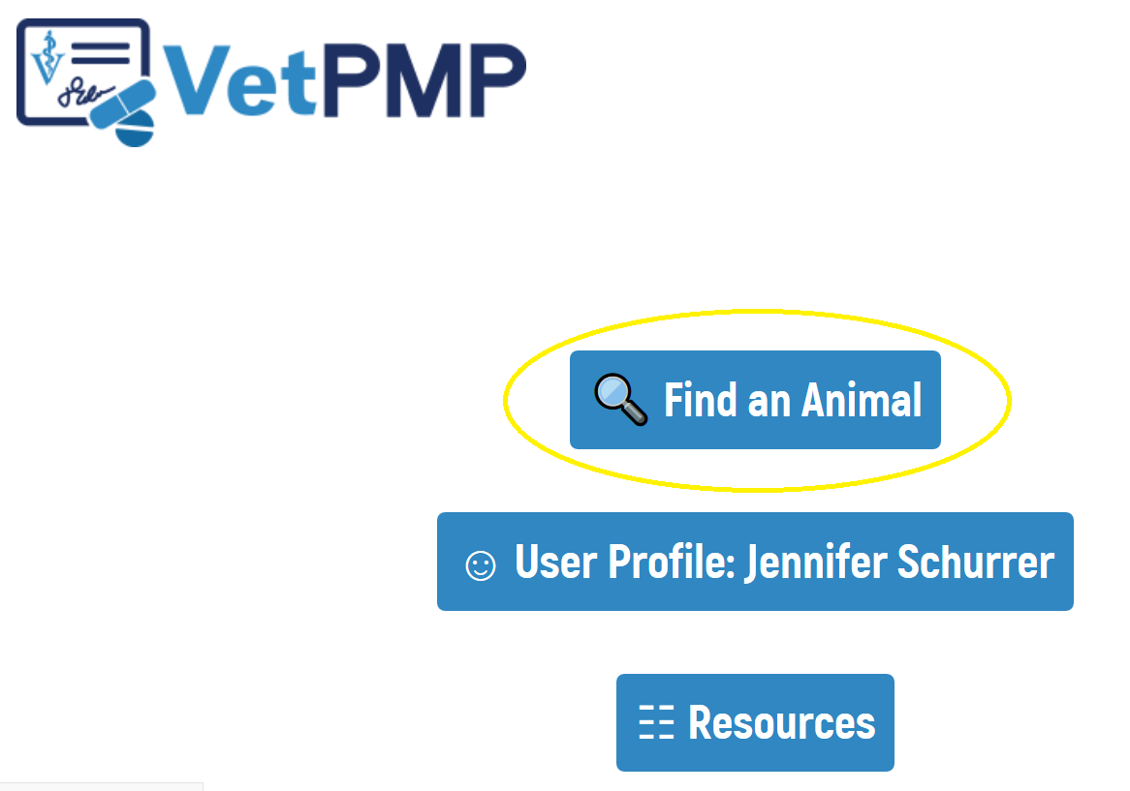
Click “Find an Animal”

Slide 4
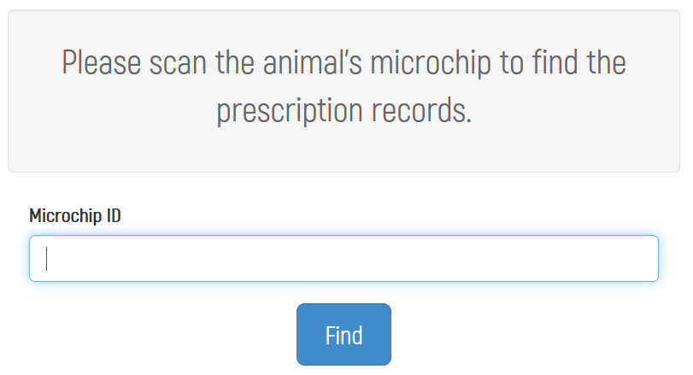
Enter the pet’s microchip number
Free type
Copy paste from electronic medical records
Use a bar code scanner to scan bar code sticker in medical record

Slide 5
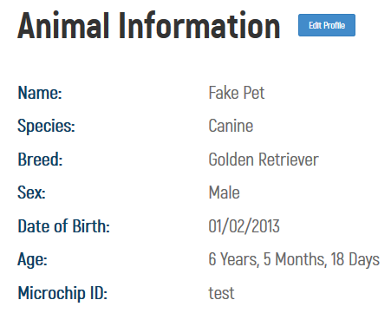
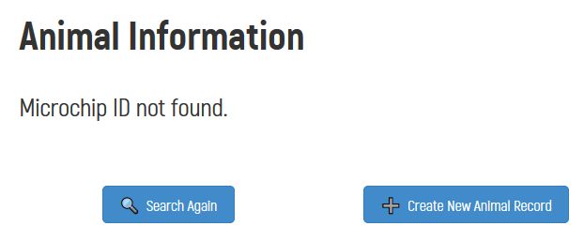
Review pet’s history
Pet not yet in the VetPMP
Pet in the VetPMP

Slide 6
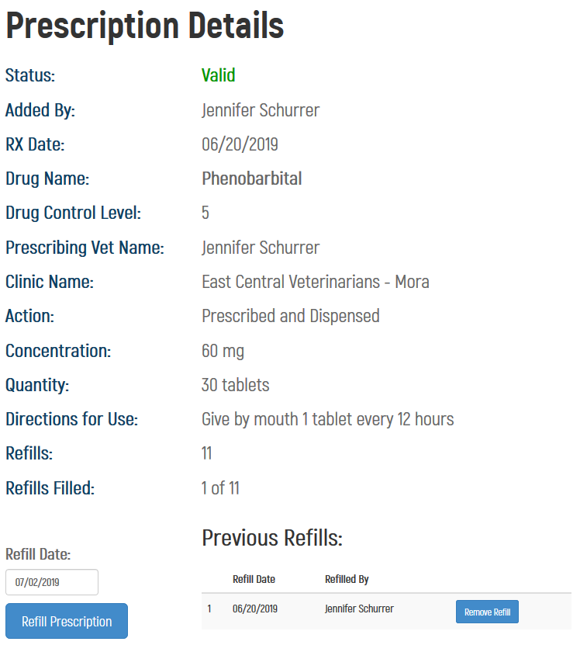
Review pet’s history

